Slide 1




Integration of beneficiaries of international protection in European countries
Results of the National Integration Evaluation Mechanism (NIEM)
27 June 2019
Alexander Wolffhardt
Migration Policy Group
Project co-financed by the Asylum, Migration and Integration Fund of the European Union
Co-funded by a grant from the Foundation Open Society Institute in cooperation with the OSIFE of the Open Society Foundations
Project V4NIEM Visegrad Countries National Integration Evaluation Mechanism co-funded by the International Visegrad Fund
Notes:
1

Slide 2
Overview
Comprehensive NIEM integration model:
monitoring tool for improved refugee integration policies
Indicators & results:
language learning & social orientation, employment incl. self-employment
Supporting migrant entrepreneurship:
measures & objectives
Notes:
2

Slide 3
Comprehensive NIEM integration model
Why monitor refugee integration?
Acknowledgment of long-term integration as durable solution for beneficiaries of international protection
Based on provisions of Geneva convention and EU law
Enduring process of developing and implementing integration policies
System to systematically and regularly assess refugee integration framework of various countries: National Integration Evaluation Mechanism (NIEM)
Identification of policy gaps and needs, based on evidence
Notes:
3

Slide 4
Comprehensive NIEM integration model
NIEM National Integration Evaluation Mechansism
Regular, indicator-based monitoring of the quality of government policies for the integration of beneficiaries of international protection in EU countries
173 indicators to measure policies and developments – indicators not to completely map policies, but selected as being indicative for quality of policies and state of development
Tool for policy-makers to identify gaps and needs – Assessment as roadmap towards comprehensive integration framework
Goals of NIEM project: establishment of indicator system & baseline research in 14 countries by research partners, policy dialogue & national advocacy coalitions, 2 evaluations to measure progress made & expand scope of indicators assessed
Notes:
4

Slide 5
Comprehensive NIEM integration model
Assessment in 13 dimensions
General conditions
Impact of reception on integration
Mainstreaming & integration governance
Legal integration
Residency
Family unity and reunification
Access to citizenship
Socio-economic integration
Housing
Employment
Vocational training &
employment-related education
Health
Social security
Socio-cultural integration
Education
Language learning & social orientation
Building bridges & fostering participation
Notes:
5

Slide 6
Comprehensive NIEM integration model
Indicators derived from international & EU standards
International legal standards
Geneva Convention, Universal Declaration of Human Rights, European Convention on Human Rights, UN Convention on the Rights of the Child, European Convention on Nationality
EU legal standards
Charter of Fundamental Rights of the European Union, Qualification Directive, Family Reunification Directive,
Reception Conditions Directive
EU policy standards
Common Basic Principles for Immigrant Integration Policy, Commission Communication on guidance for application of the Family Reunification Directive
Notes:
6

Slide 7
Comprehensive NIEM integration model
Building blocks of a comprehensive integration policy
Step Setting the Legal Framework - Are laws in place to implement integration principles?
Step Building the Policy Framework - Are policies in place to implement integration principles?
Step Implementation & Collaboration - Has the government invested in the infrastructure and cooperation structures to implement these policies and services in partnership with all relevant stakeholders (local authorities, NGOs,...)?
Step Reliable Data & Evaluation - Are all the data available necessary to plan polices and evaluate their success?
Step Providing Financial & Human Resources - Does the governments commit sufficient financial and staff resources and effectively use EU financial support?
Step Achieving Integration Outcomes - Do beneficiaries of international protection who access and use these services have greater participation and well-being in society?
Notes:
7

Slide 8
Comprehensive NIEM integration model
The European benchmark for refugee integration: A comparative analysis of the National Integration Evaluation Mechanism in 14 EU countries (2019)
Baseline research completed,
results for recognised refugees & beneficiaries of subsidiary protection
Turkey: Civil Society Dialogue Harmonisation of Refugee Project (2017) - referred to indicators informing NIEM
Step Setting the Legal Framework ✓
Step Building the Policy Framework ✓
Step Implementation & Collaboration ✓
Step Reliable Data & Evaluation
Step Providing Financial & Human Resources
Step Providing Integration Outcomes
currently, 3 out of 6 Steps can be assessed comparatively: scores on scale 0 to 100
NIEM Evaluations 1 and 2 to fill data gaps in remaining 3 Steps
Towards all-out refugee integration index based on complete set of indicators

Slide 9
Comprehensive NIEM integration model
Step Setting the Legal Framework
… refers to the legal standards which a country needs to comply with to ensure most supportive frame conditions.
Across the various dimensions, the Step Setting the Legal Framework includes indicators on
  type and duration of residence permits
  conditions for obtaining long-term residence, family reunion and citizenship
  access to services, benefits and entitlements across different policy areas
e.g. employment: Access to employment - Access to self-employment -
Right to recognition of formal degrees and right to skills validation for beneficiaries of international protection - Recognition procedures of foreign diplomas, certificates, and other evidence of formal qualifications - Support in the recognition of foreign diplomas, certificates, and other formal qualifications

Slide 10
Comprehensive NIEM integration model
Step Building the Policy Framework
… refers to the policies and their rules and arrangements that a country needs to put in place to support the integration of beneficiaries in all relevant policy areas.
Across the various dimensions, the Step Building the Policy Framework includes indicators on
  availability, scope and duration of targeted provisions/services
  provisions for special needs groups
  needs-based criteria for the allocation of goods/provisions
  administrative barriers (procedures, costs, delays)
  fees for long-term residence, family reunion and citizenship
  awareness-raising/information for stakeholders and beneficiaries
e.g. employment: Access to employment for groups of special concern - Administrative barriers to accessing employment - Awareness raising about the specific labour market situation of beneficiaries of international protection - Assessment of skills - Job-seeking counselling and positive action - Targeted support for entrepreneurs
Notes:
10

Slide 11
Comprehensive NIEM integration model
Step Implementation & Collaboration
…refers to the overall efforts at developing, coordinating and implementing an all-of-government and all-of-society response, recognising integration as a key challenge for the receiving state and society.
Across the various dimensions, the Step Implementation & Collaboration includes indicators on
  existence and implementation of an overall refugee integration policy/strategy
  mainstreaming across all relevant policy fields
  multi-level and multi-sectoral coordination with local/regional authorities, social partners and civil society
  acknowledgment of integration as a two-way process
  encouragement of, and support for, an active role of the receiving society
e.g. employment: Mechanisms to mainstream the integration of beneficiaries of international protection into employment policies - Coordination with regional and local authorities on employment for beneficiaries of international protection - Partnership on employment with expert NGOs or non-profit employment support organisations

Slide 12
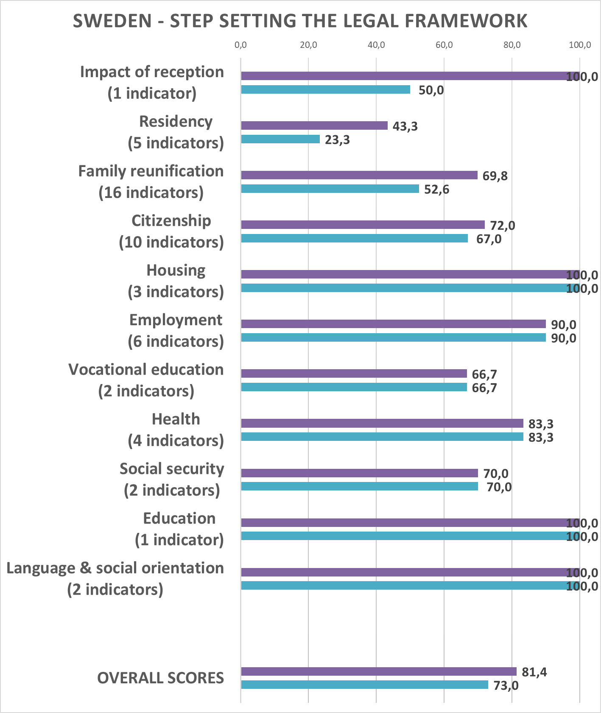
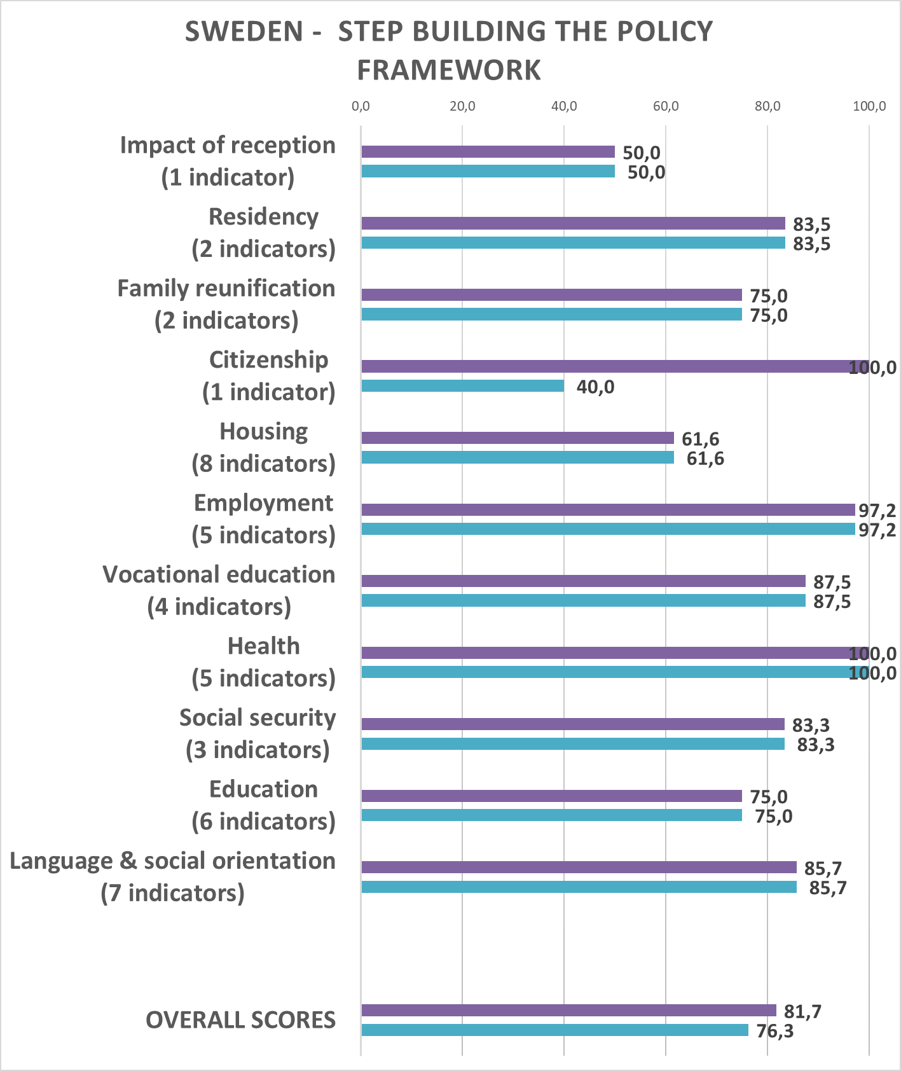
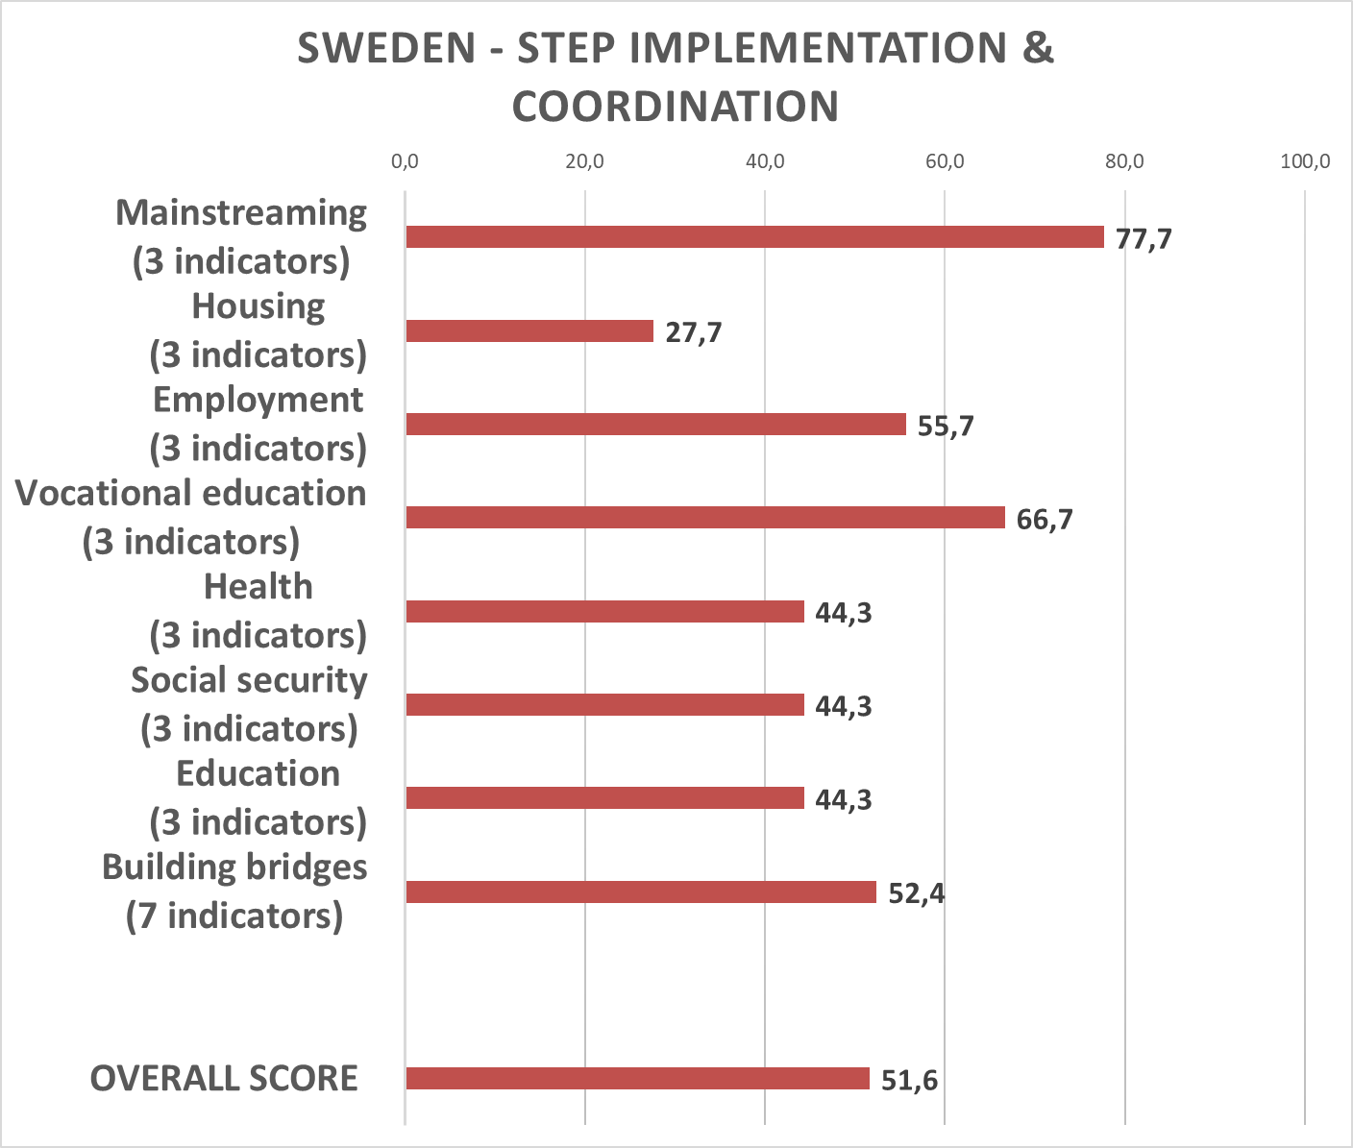
Comprehensive NIEM integration model
Comparing countries across Steps - e.g. Sweden

Slide 13
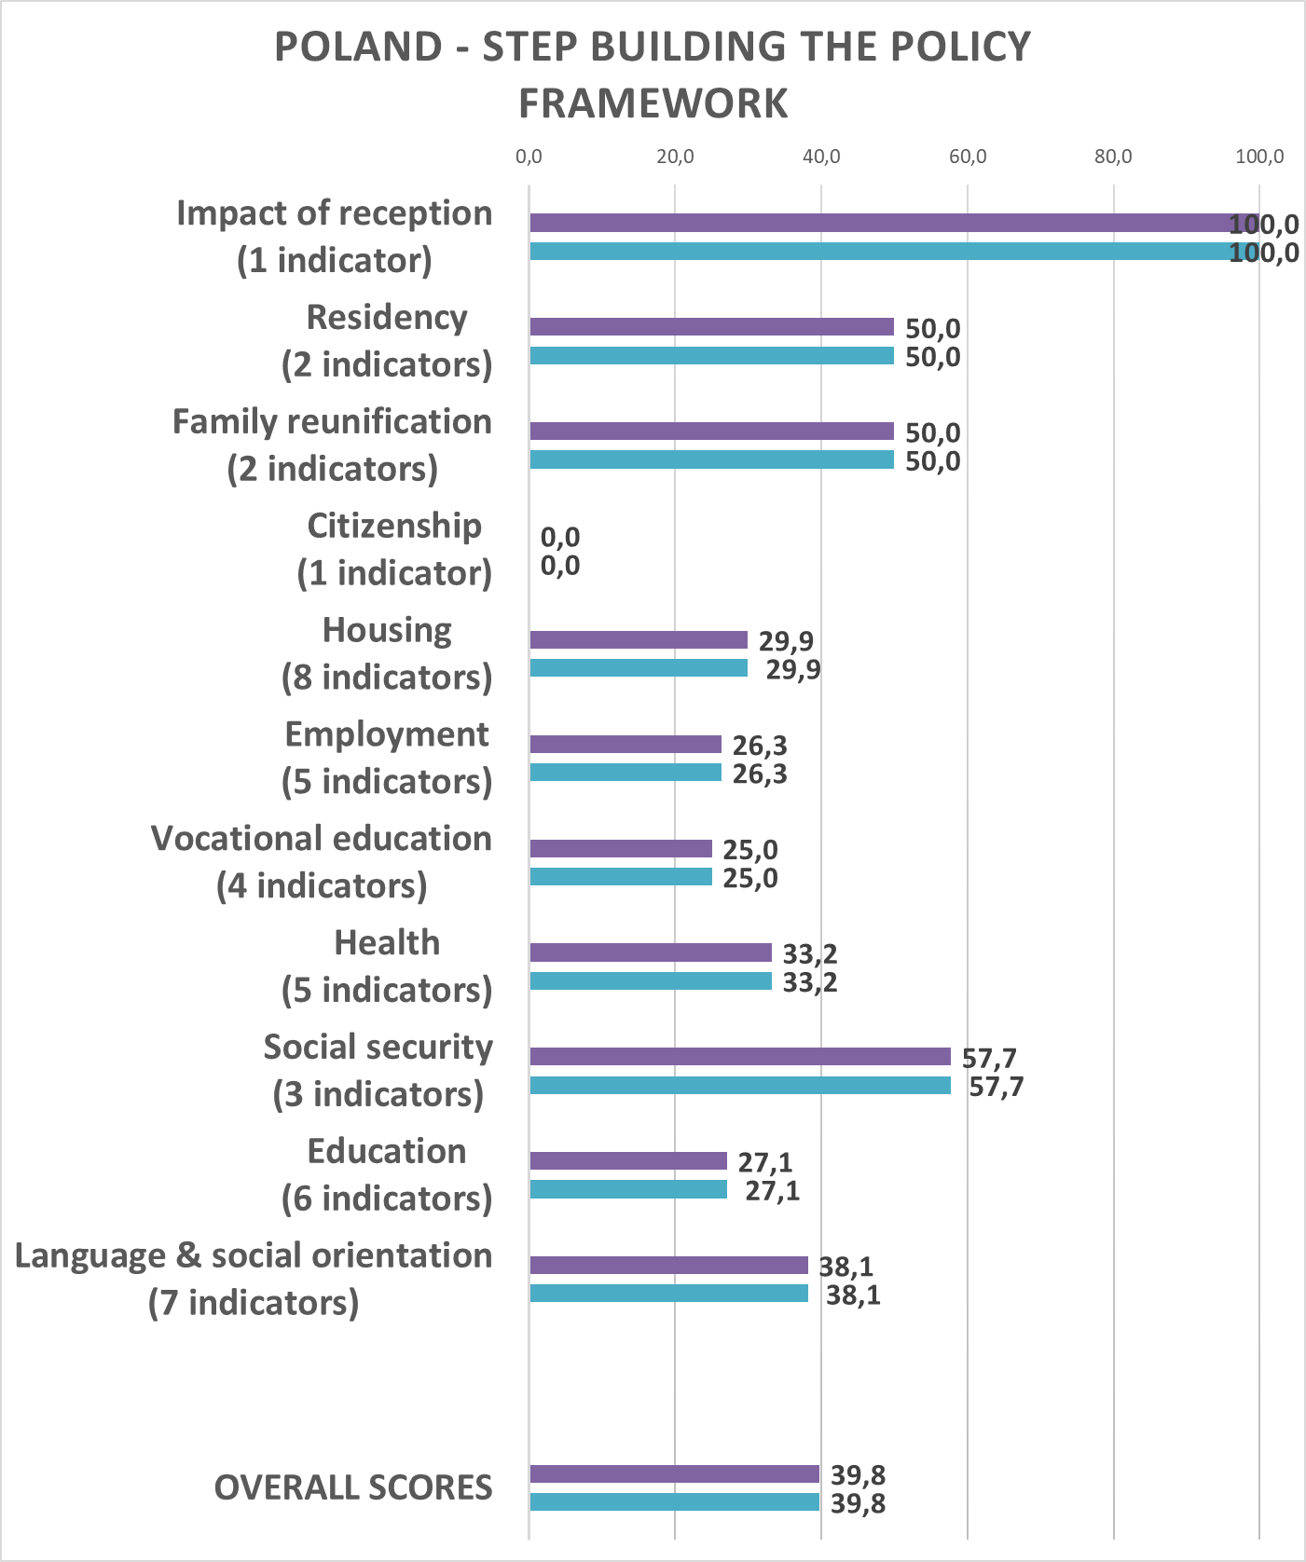
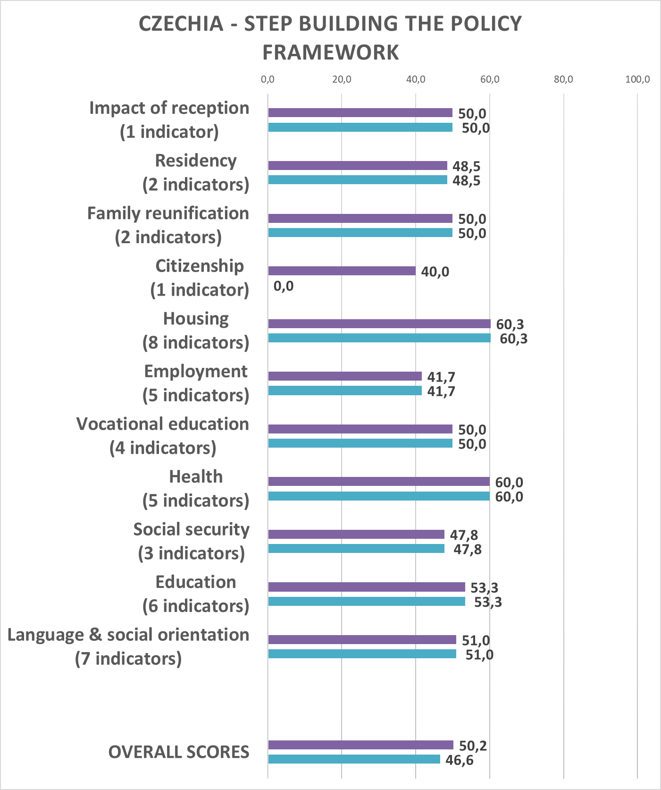
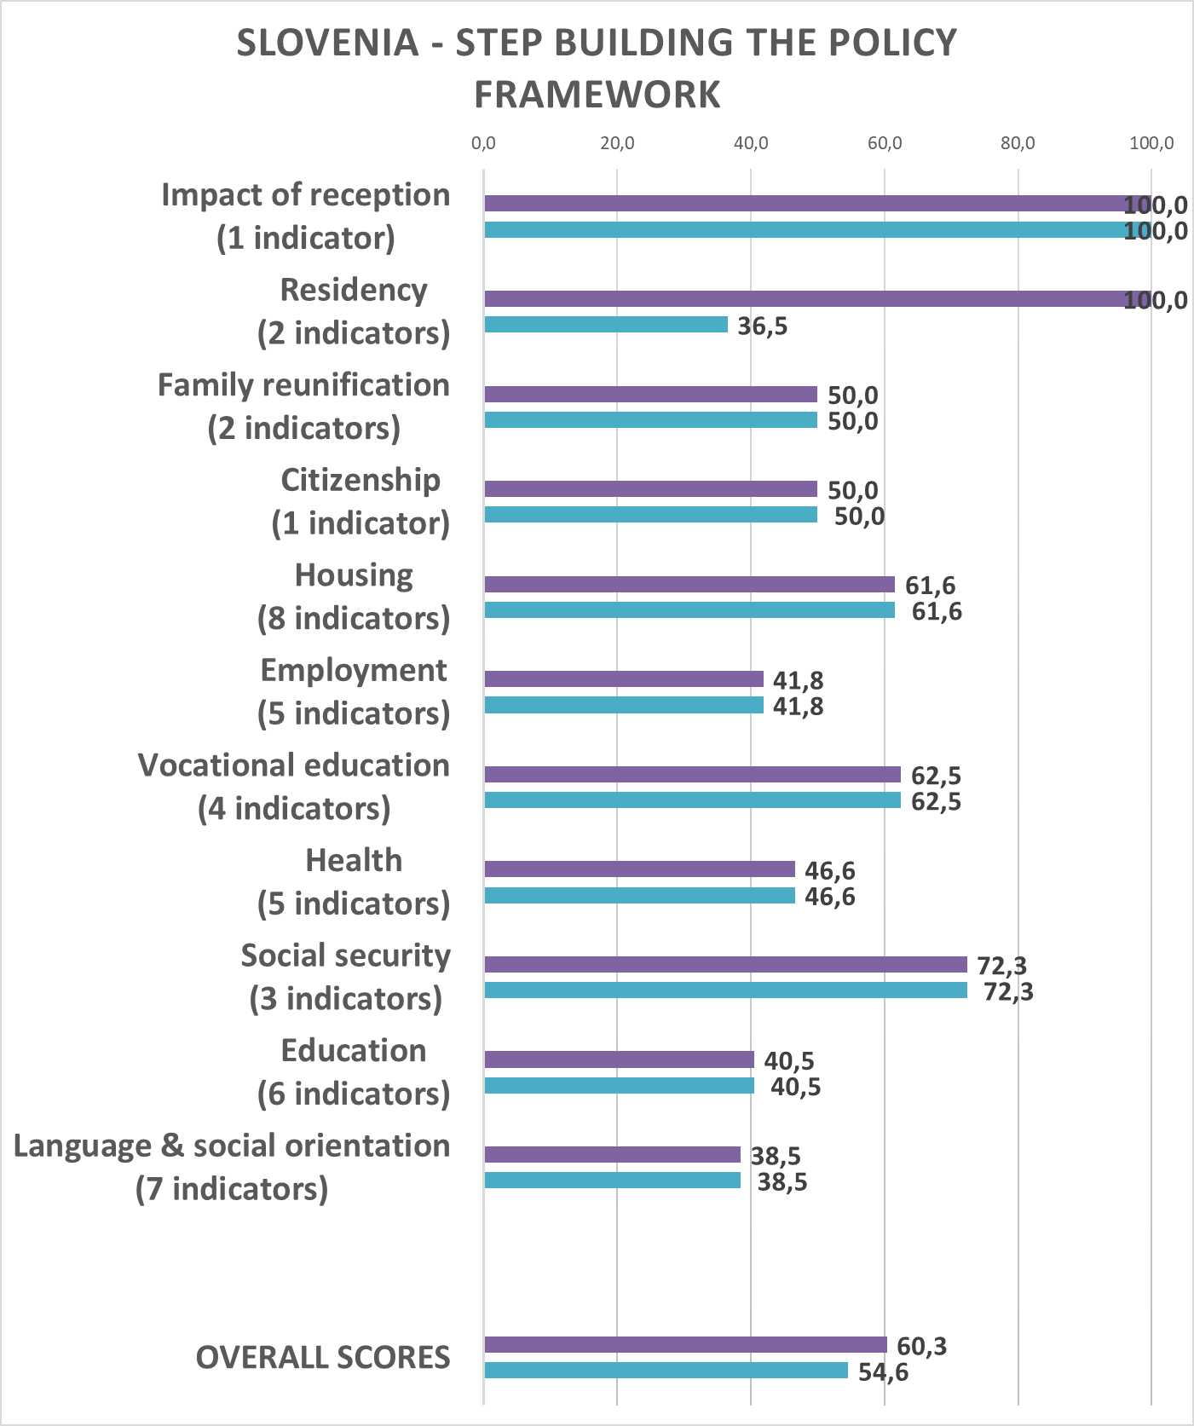
Comprehensive NIEM integration model
Comparing countries within Steps – e.g. Policy Framework in Poland, Czechia & Slovenia

Slide 14
Indicators & results
Language learning & social orientation
Notes:
14

Slide 15
Indicators & results
Access to publicly funded host language learning
Notes:
15

Slide 16
Indicators & results
Duration of host language learning
Notes:
16

Slide 17
Indicators & results
Quality of language courses
Notes:
17

Slide 18
Indicators & results
Employment
Notes:
18

Slide 19
Indicators & results
Access to employment
Notes:
19

Slide 20
Indicators & results
Right to recognition of formal degrees &
right to skills validation
Notes:
20

Slide 21
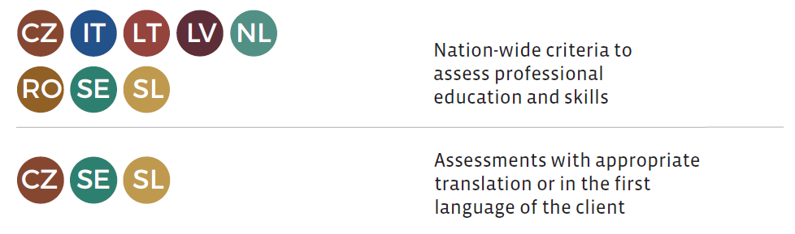
Indicators & results
Assessment of professional education and skills
Notes:
21

Slide 22
Indicators & results
Job-seeking counselling and positive action
Notes:
22

Slide 23
Indicators & results
Coordination with regional and local authorities on employment for BIPs
Notes:
23

Slide 24
Indicators & results
Partnership on employment with expert NGOs or non-profit employment support organisations
Notes:
24

Slide 25
Indicators & results
Access to
self-employment
Equal access as nationals in nearly all countries (not LV)
But barriers in access to liberal professions frequent (e.g. citizenship requirements)
Notes:
25

Slide 26
Indicators & results
Targeted support for entrepreneurs
Only few countries provide continuous support for refugees starting a business beyond on-off projects
SE: mainstreamed into introduction plan for newcomers and country-wide entrepreneurship support system, incl. for migrants
Mostly linked to overall migrant entrepreneurship support policies
Notes:
26

Slide 27

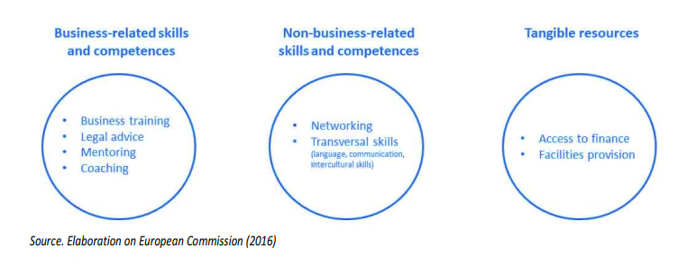
Supporting migrant entrepreneurship
Comprehensive approach
Handbook Measures to support early stage migrant entrepreneurs with more than 30 good practices
Notes:
27

Slide 28
Supporting migrant entrepreneurship
Comprehensive approach
Legal and practical advice on setting up and running a business, geared to the specific needs of migrant entrepreneurs including language and residency aspects.
Individual business support, advising on the entire business cycle from development of business ideas and -plans to the start-up and growth phase.
Targeted business training, taking into account the specific needs of (potential) entrepreneurs arriving from other regulatory, educational and linguistic contexts.
Mentoring through experienced entrepreneurs, to support skill and knowledge development and to provide role models, incl. effective mentor/mentee matching procedures.
Networking between potential, newly established and successful migrant entrepreneurs, with the suppliers and customers of the mainstream economy, as well as business associations.
Notes:
28

Slide 29
Supporting migrant entrepreneurship
Comprehensive approach
Language- and cultural sensitivity in the provision of entrepreneurship support services to immigrants, including multilingual information and outreach to communities.
Visibility for migrants of existing entrepreneurship support services, and for the wider public of the contributions that migrant businesses make to prosperity.
Access to finance for potential and established migrant businesses, including obstacle-free access to credit from mainstream loaning institutions as well as alternative funding sources.
Provision of facilities and incubating services for e.g. immigrant-run start-ups or one-person businesses that lack working space and technical infrastructures.
cf. European Commission (2016). Evaluation and Analysis of Good Practices in Promoting and Supporting Migrant Entrepreneurship: Guide Book
Notes:
29

Slide 30
Thank you for your attention!
www.forintegration.eu
https://www.facebook.com/allinforintegration/
#AllInForIntegration
To access the NIEM report:
www.forintegration.eu
For further questions concerning NIEM research activities:
Carmine Conte, Legal Policy Analyst, cconte@migpolgroup.com
Alexander Wolffhardt, Policy Analyst, awolffhardt@migpolgroup.com
To access the MEGA handbook:
www.migrant-entrepreneurship.eu
For further questions concerning the Migrant Entrepreneurship Growth Agenda (MEGA)
Giacomo Solano, Policy & Statistical Analyst, gsolano@migpolgroup.com
Aldo Xhani, Project Manager, axhani@migpolgroup.com
Notes:
30

